Slide 1
Lecture 12.4 Vertical Integration versus long-term contracts

Slide 2
Vertical Integration vs. Long Term Contracts
Consider a firm (AutoCorp) that wishes to purchase car bodies.
Should they vertically integrate or write a long-term contract?
There are several factors to consider
contracts may be incomplete
ownership and investment incentives
specific assets
asset ownership

Slide 3
Vertical Integration vs. Long Term Contracts
Consideration 1: Incomplete contracts
If a complete contract was possible, then it would not matter if AutoCorp made their own car bodies or wrote a long term purchase contract.
But contracts are often incomplete. Possible problems include:
difficulty in specifying all possible contingencies
the cost of negotiating contracts
the difficulty and cost of contract enforcement

Slide 4
Vertical Integration vs. Long Term Contracts
Consideration 2: Ownership and Investment incentives.
Recall the Property Rights theory of the firm: ownership determines the residual use of an asset
vertical integration ensures that asset ownership stays within the firm
long term contracts allow ownership to reside outside the firm
asset ownership influences investment incentives

Slide 5
Vertical Integration vs. Long Term Contracts
Consideration 3: Specific Assets
Specific investments place the investor in a tenuous position.
Consider the problem faced by the potential supplier to AutoCorp (a producer of new autos), BodyWorks (which makes the chassis).
BodyWork may have to construct a plant near AutoCorp’s factory.
Once the plant is built, AutoCorp has an incentive to rewrite the contract
This reduces the incentive for BodyWorks to make investments
It is also possible that the hold up problem goes the other way
e.g. AutoCorp makes a specific investment to tailor production to the chassis made by BodyWorks
This example is related to the classic case of GM and Fisher Body

Slide 6
Vertical Integration vs. Long Term Contracts
When is it better to use long term contracts?
When assets are less specific, markets are more likely to produce efficient outcomes
When there is greater uncertainty, specific assets pose greater problems. Contingencies become more important, and these may be difficult to contract for.
To vertically integrate, AutoCorp could buy BodyWorks, or BodyWorks could buy AutoCorp
the ownership structure matters!

Slide 7
Vertical Integration vs. Long Term Contracts
Consideration 4: Asset Ownership
AGT manufactures modems, and CCC makes circuit boards (an important input)
AGT is CCC’s only customer
CCC is the sole supplier of circuit boards for AGT
assume circuit boards are firm specific
The value that each party gets from the transaction depends on their investment or effort
investment by AGT could increase the value of the modem
investment by CCC could reduce the cost of the circuit board

Slide 8
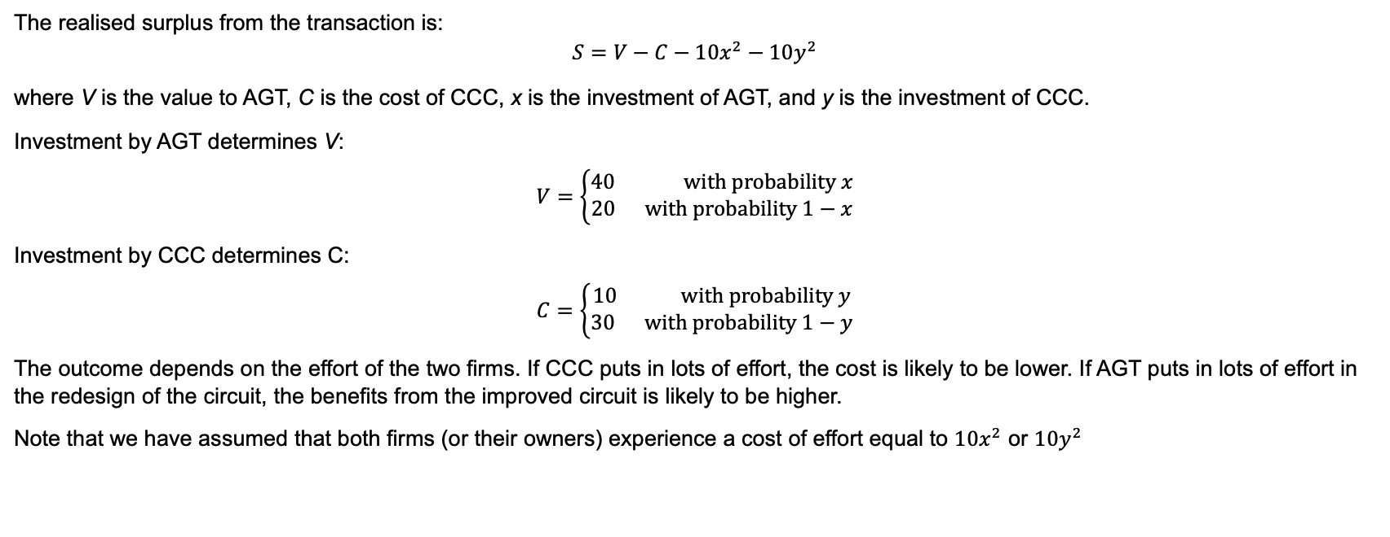
Vertical Integration vs. Long Term Contracts
The realised surplus from the transaction is:
$$S=V−C−10x^{2}−10y^{2}$$
where V is the value to AGT, C is the cost of CCC, x is the investment of AGT, and y is the investment of CCC.
Investment by AGT determines V:
$$V=\left\{\begin{aligned}40 \text{with} \text{probability} x \\ 20 \text{with} \text{probability} 1−x\end{aligned}\right.$$
Investment by CCC determines C:
$$C=\left\{\begin{aligned}10 \text{with} \text{probability} y \\ 30 \text{with} \text{probability} 1−y\end{aligned}\right.$$
The outcome depends on the effort of the two firms. If CCC puts in lots of effort, the cost is likely to be lower. If AGT puts in lots of effort in the redesign of the circuit, the benefits from the improved circuit is likely to be higher.
Note that we have assumed that both firms (or their owners) experience a cost of effort equal to $10x^{2}$ or $10y^{2}$

Slide 9
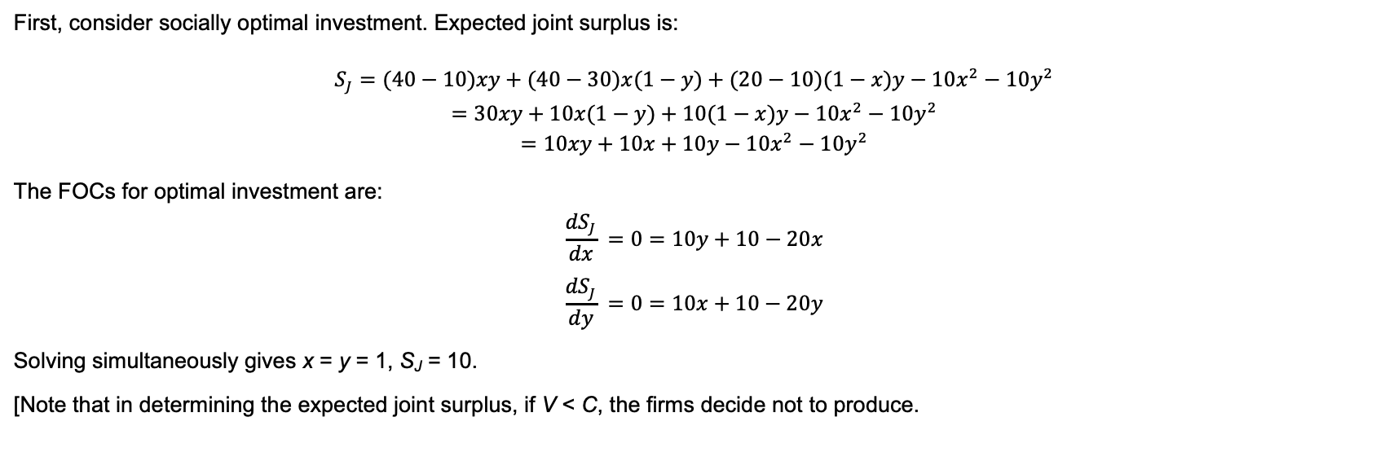
Vertical Integration vs. Long Term Contracts
First, consider socially optimal investment. Expected joint surplus is:
$$S_{J}=(40−10)xy+(40−30)x(1−y)+(20−10)(1−x)y−10x^{2}−10y^{2}$$
$$=30xy+10x(1−y)+10(1−x)y−10x^{2}−10y^{2}$$
$$=10xy+10x+10y−10x^{2}−10y^{2}$$
The FOCs for optimal investment are:
$$\frac{{dS}_{J}}{dx} =0=10y+10−20x$$
$$\frac{{dS}_{J}}{dy} =0=10x+10−20y$$
Solving simultaneously gives x = y = 1, S_{J} = 10.
[Note that in determining the expected joint surplus, if V < C, the firms decide not to produce.

Slide 10
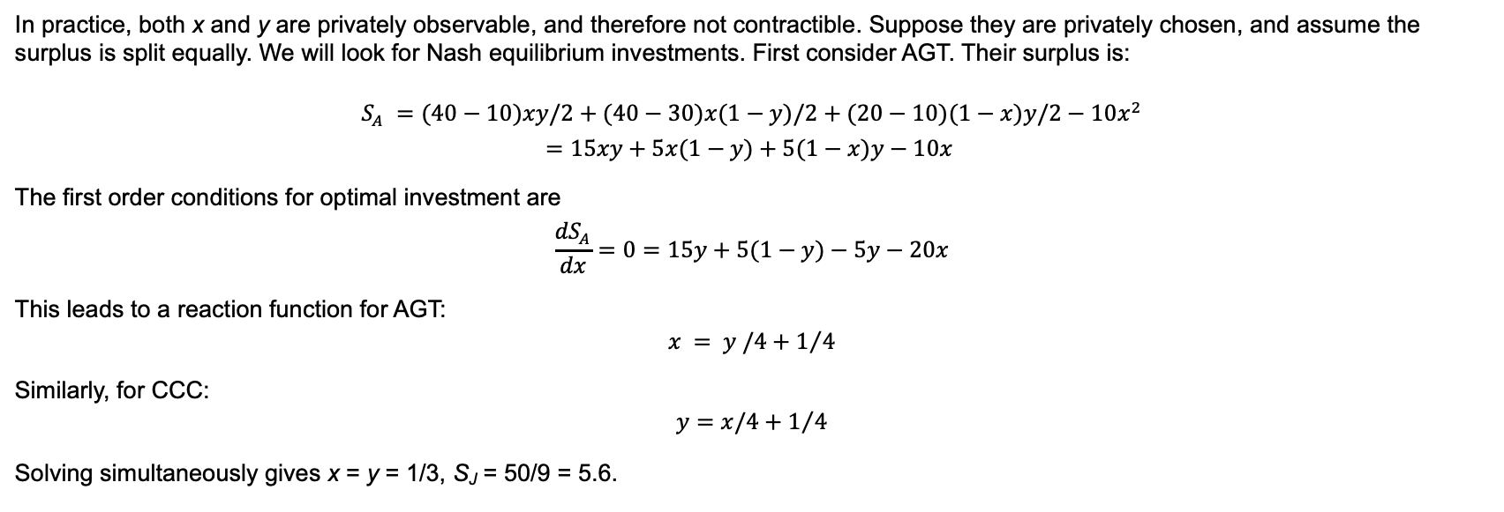
Vertical Integration vs. Long Term Contracts
In practice, both x and y are privately observable, and therefore not contractible. Suppose they are privately chosen, and assume the surplus is split equally. We will look for Nash equilibrium investments. First consider AGT. Their surplus is:
$$S_{A} =(40−10)xy/2+(40−30)x(1−y)/2+(20−10)(1−x)y/2−10x^{2}$$
$$=15xy+5x(1−y)+5(1−x)y−10x$$
The first order conditions for optimal investment are
$$\frac{{dS}_{A}}{dx}=0=15y+5(1−y)−5y−20x$$
This leads to a reaction function for AGT:
$$x = y /4+1/4$$
Similarly, for CCC:
$$y=x/4+1/4$$
Solving simultaneously gives x = y = 1/3, S_{J} = 50/9 = 5.6.

Slide 11
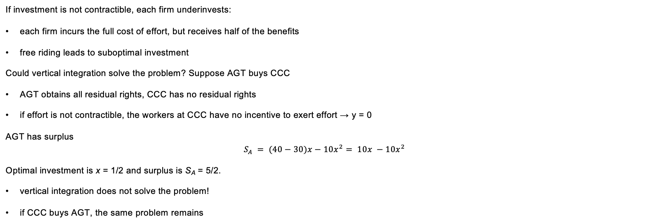
Vertical Integration vs. Long Term Contracts
If investment is not contractible, each firm underinvests:
each firm incurs the full cost of effort, but receives half of the benefits
free riding leads to suboptimal investment
Could vertical integration solve the problem? Suppose AGT buys CCC
AGT obtains all residual rights, CCC has no residual rights
if effort is not contractible, the workers at CCC have no incentive to exert effort → y = 0
AGT has surplus
$$S_{A} = (40−30)x−10x^{2}= 10x −10x^{2}$$
Optimal investment is x = 1/2 and surplus is S_{A} = 5/2.
vertical integration does not solve the problem!
if CCC buys AGT, the same problem remains

Slide 12
Vertical Integration vs. Long Term Contracts
Key lesson: vertical integration is not always superior to a long term contract
separate ownership actually gives more value in this example
investments (or effort) are impacted by organisational structure
When might it be better to give stronger incentives to one party?

